Slide 1
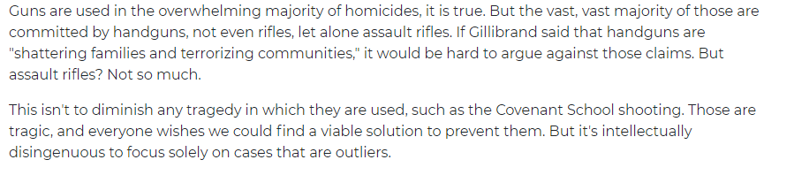
Fallacy of insufficient evidence
“Guns are like hammers—they're both tools with metal parts that could be used to kill someone”
Fallacy type: Weak Analogy
Source: https://www.washingtonexaminer.com/opinion/hammers-used-to-kill-more-people-than-assault-weapons
Notes:
Pham Thanh Thien

Slide 2
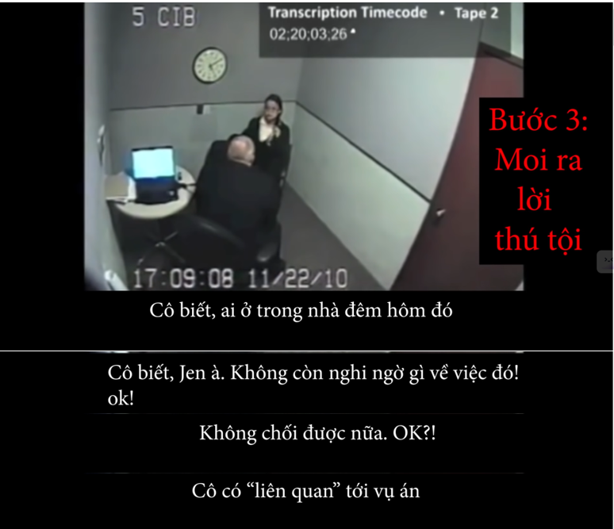
Fallacy of insufficient evidence
Jennifer Pan _ Reid question
Text 1:
“You know who is in the house that night.”
“You know, Jen. There is no doubt about that! OK!?”
“And no denying about that ok!?”
“So you are involved in this.”
Fallacy type: Loaded question
Source: https://www.youtube.com/watch?v=Y0wkWtOs1aY&t=7853s
Notes:
Nguyễn Ngọc Minh Tú – FAFBIU22262 2. Trần Nguyễn Minh Thư – FAFBIU22258 3. Nguyễn Thảo Như – FAFBIU22256 4. Phạm Vũ Uyên Nhi – FAFBIU22255 5. Lưu Nguyễn Ngọc Nhi – FAFBIU22134 6. Nguyễn Trương Trúc Linh - FAFBIU22085 7. Dương Trung Tín - MAMAIU22155

Slide 3
Fallacy of insufficient evidence
Text 5:
Trump attempts to justify why he considers appropriate to build a huge wall on the North American southern border.
According to him, “Mexico is sending people that have lots of problems”, not “the good ones” these people bring drugs, crime, and the most shocking of his remarks: “they are rapists”
Fallacy type:
Slippery slope
https://time.com/4473972/donald-trump-mexico-meeting-insult/
Notes:
Nguyễn Ngọc Minh Tú – FAFBIU22262 2. Trần Nguyễn Minh Thư – FAFBIU22258 3. Nguyễn Thảo Như – FAFBIU22256 4. Phạm Vũ Uyên Nhi – FAFBIU22255 5. Lưu Nguyễn Ngọc Nhi – FAFBIU22134 6. Nguyễn Trương Trúc Linh - FAFBIU22085 7. Dương Trung Tín - MAMAIU22155

Slide 4
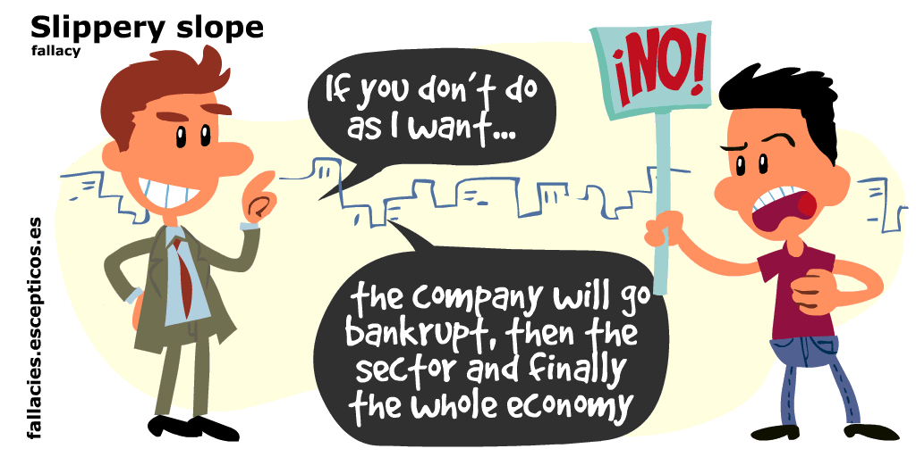
Fallacy of insufficient evidence
Text 1:
Fallacy type:slippery slope fallacy
Source:https://fallacies.escepticos.es/index.php/falacia-de-la-pendiente-resbaladiza/
Notes:
Ngô Quốc Duy – EEACIU22179
Vũ Đình Kiên – EEACIU22225
Lê Tấn Duy - EEACIU22208
Nguyễn Minh Duy – EEACIU22223
Nguyễn Võ Minh Thông- EEACIU222303
Trần Gia Bảo- EEACIU22217

Slide 5
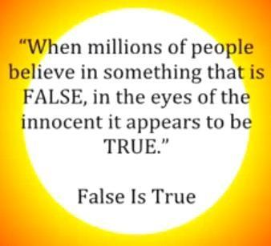
Fallacy of insufficient evidence
Text 2:
Fallacy type: Appeal to popularity/bandwagon
Source: October | 2014 | JREnsey Blog (wordpress.com)
Notes:
Ngô Quốc Duy – EEACIU22179
Vũ Đình Kiên – EEACIU22225
Lê Tấn Duy - EEACIU22208
Nguyễn Minh Duy – EEACIU22223
Nguyễn Võ Minh Thông- EEACIU222303
Trần Gia Bảo- EEACIU22217

Slide 6
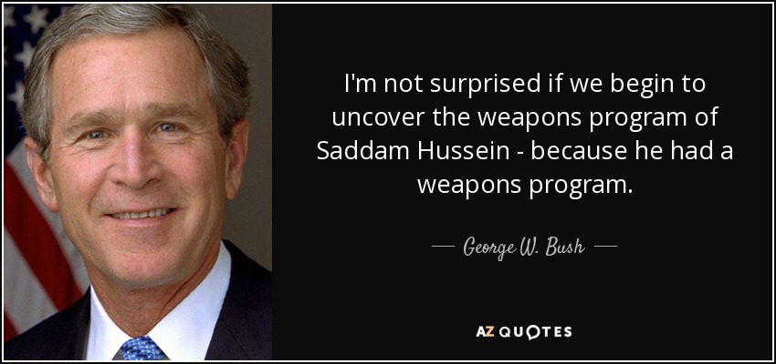
Fallacy of insufficient evidence
Text 4:
Fallacy type: Begging the question
Source: https://www.azquotes.com/quotes/topics/wmds-in-iraq.html?p=2
Notes:
Nguyễn Việt Khang-EEACIU22209
Trần Quang Cường-EEACIU22214
Nguyễn Văn Gia Huy-EEACIU22231
Phạm Ngọc Thế Huy–EEACIU22210
Phạm Nguyên Khoa-EEACIU22212

Slide 7
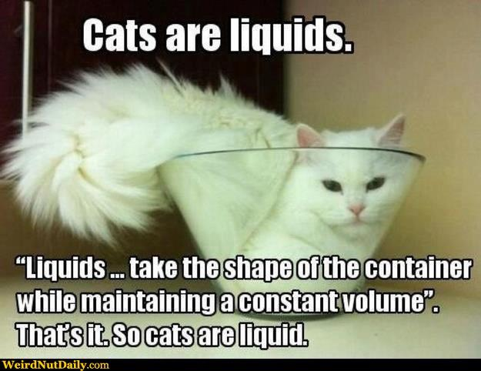
Fallacy of insufficient evidence
Text 1:
Fallacy type: Weak analogy
Source: Internet
Notes:
1. Nguyễn Phước Trọng Nhân - EEEEIU22076
2. Đinh Gia Đạt - EEEEIU22060
3. Trần Đăng Khoa - EEEEIU22071
4. Vương Thanh Tùng - EEEEIU22079
5. Lạc Dương Tân - EEEEIU22045
6. Nguyễn Trung Tín - EEEEIU2088
7. Trần Ngọc Khôi Nguyên - EEEEIU22077
8. Nguyễn Thành Nhân - EEEEIU22073

Slide 8
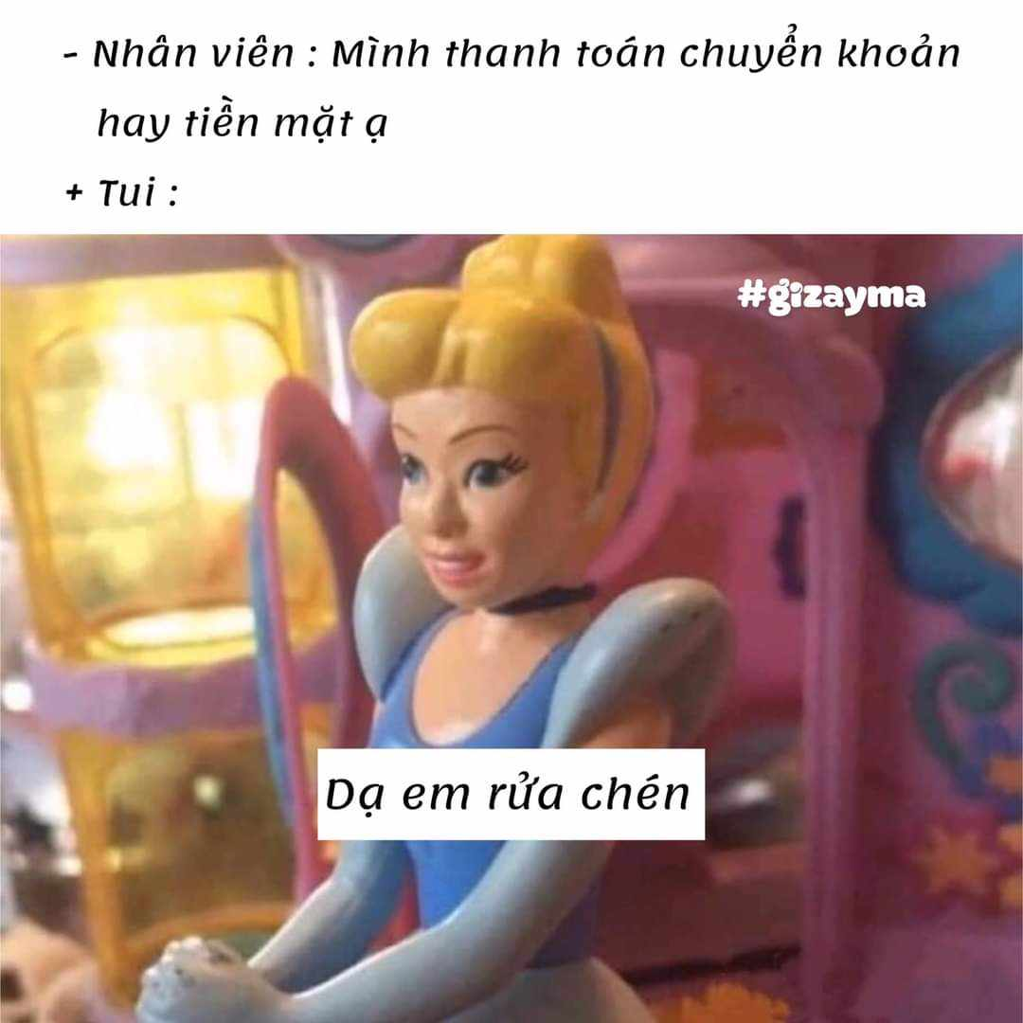
Fallacy of insufficient evidence
Text 2:
Fallacy type: Red herring
Source: Internet
Notes:
1. Nguyễn Phước Trọng Nhân - EEEEIU22076
2. Đinh Gia Đạt - EEEEIU22060
3. Trần Đăng Khoa - EEEEIU22071
4. Vương Thanh Tùng - EEEEIU22079
5. Lạc Dương Tân - EEEEIU22045
6. Nguyễn Trung Tín - EEEEIU2088
7. Trần Ngọc Khôi Nguyên - EEEEIU22077
8. Nguyễn Thành Nhân - EEEEIU22073

Slide 9
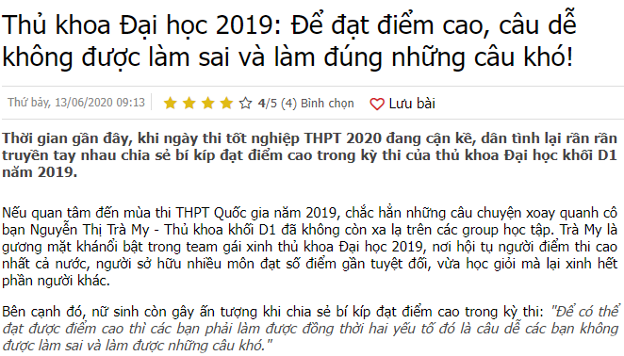
Fallacy of insufficient evidence
Text 3:
Fallacy type: False Alternatives
Source: https://tintuc.vn/thu-khoa-dai-hoc-2019-de-dat-diem-cao-cau-de-khong-duoc-lam-sai-va-lam-dung-nhung-cau-kho-post1730749
Notes:
1. Nguyễn Phước Trọng Nhân - EEEEIU22076
2. Đinh Gia Đạt - EEEEIU22060
3. Trần Đăng Khoa - EEEEIU22071
4. Vương Thanh Tùng - EEEEIU22079
5. Lạc Dương Tân - EEEEIU22045
6. Nguyễn Trung Tín - EEEEIU2088
7. Trần Ngọc Khôi Nguyên - EEEEIU22077
8. Nguyễn Thành Nhân - EEEEIU22073

Slide 10
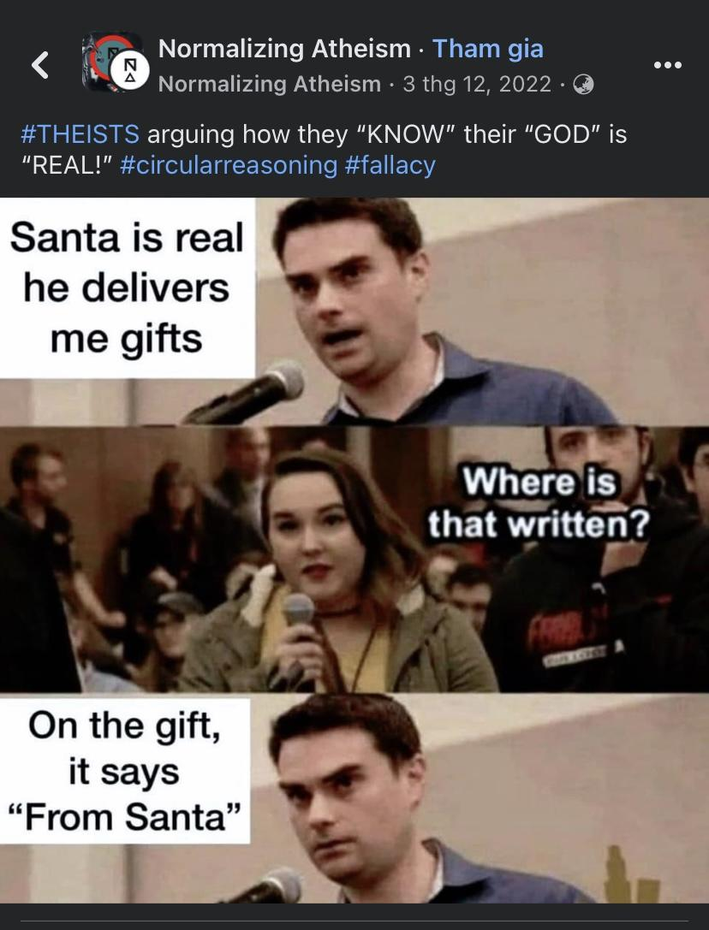
Fallacy of insufficient evidence
Text 3:
Fallacy type: In appropriate Appeal to authority
Source: https://www.facebook.com/groups/normalizingatheism/permalink/634350921776631/?mibextid=S66gvF
Notes:
Cao Quốc Tuấn – IELSIU22341 2. Nguyễn Ngọc Phương Uyên – IEIEIU22088 3. Võ Thị Thanh Nhã – IELSIU22330 4. Trần Khánh Linh – IELSIU22382 5. Trần Vũ Quỳnh Giang – IELSIU22025 6. Trần Thiên Ân – IELSIU22289 7. Nguyễn Duy Thiên – IELSIU22302 8. Trần Nguyễn Khánh Nhân – IELSIU22301

Slide 11
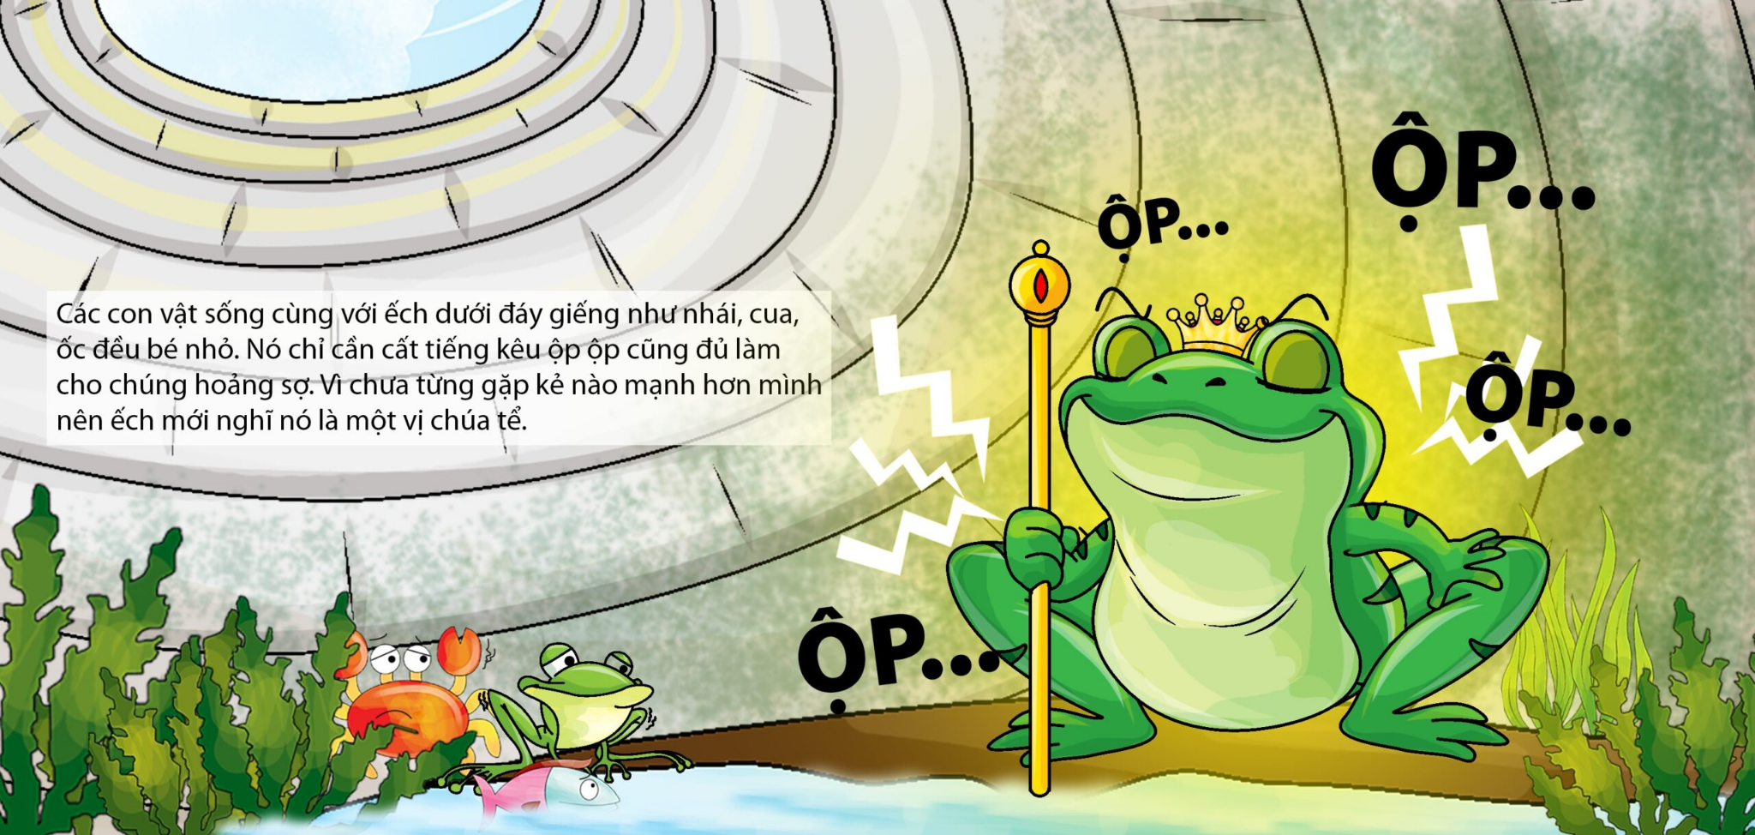
Assignment
Fallacy type: Composition
Source: folk tale, 7th grade literature textbook
Notes:
Nguyễn Ngọc Uyên Phương_IEIEIU22030
Nguyễn Trần Anh Thư_IEIEIU22038
Hoàng Hải Phong_IELSIU22320
Đặng Huỳnh Anh Huy_IELSIU22316
Trương Quang Khải - IEIEIU22077
Hoàng Ngọc Minh - IEIEIU22076
Trần Văn Hiếu - IEIEIU22079IEIEIU22079

Slide 12
Chapter 7
Analyzing Arguments
Objectives:
To see the logical structures of short arguments
To add clarity to long and confusing arguments

Slide 13
Part 1
Diagramming Short Arguments

Slide 14
Arguments – Review
Arguments consist of premises and conclusions.
Premises and conclusions are statements.

Slide 15
Arguments – Review
Premise indicator words:
since, because, for, given that, seeing that, considering that, inasmuch as, as, in view of the fact that, as indicated by, judging from, on account of
Conclusion indicator words:
therefore, thus, hence, consequently, so, accordingly, it follows that, for this reason, that is why, which shows that, wherefore, this implies that, as a result, this suggests that, this being so, we may infer that, etc.

Slide 16
Diagramming Short Arguments
Argument:
The death penalty should be abolished because it’s racially discriminatory, there’s no evidence that it’s more effective than life imprisonment, and innocent people may be executed by mistake.

Slide 17
Diagramming Short Arguments
Step 1: Identify (circle, underline, etc.) all premise and / or conclusion indicators.
The death penalty should be abolished because it’s racially discriminatory, there’s no evidence that it’s more effective than life imprisonment, and innocent people may be executed by mistake.

Slide 18
Diagramming Short Arguments
Step 2: Number the statements consecutively as they appear in the argument.
The death penalty should be abolished
because it’s racially discriminatory,
there’s no evidence that it’s more effective than life imprisonment, and
innocent people may be executed by mistake.

Slide 19
Diagramming Short Arguments
Step 3: Arrange the numbers on a page with the premises placed above the conclusion(s) they claim to support.
2) 3) 4)
1)

Slide 20
Diagramming Short Arguments
Step 4: Omit any logically irrelevant statements.
Step 5: Use arrows to mean ‘is offered as evidence for’ to show the relationship of argument support.
2) 3) 4)
1)
2), 3), and 4) offer independent support for the conclusion.

Slide 21
Independent vs. Linked Support
Example 1
1) Nick doesn’t own a car.
2)He has poor vision.
3) He lives near the stadium.
4) So, Nick probably won’t drive a car to the game.
Example 2
1) No student skipping Chapter 7 can do well on the writing test.
2) Henry skipped Chapter 7.
3) So, Henry couldn’t do well on the writing test.

Slide 22
Diagramming Short Arguments
Independent support: does not weaken or destroy any other premise but offers less support for the conclusion
1) 2) 3)
4)
Linked support: works cooperatively with another premise to support the conclusion
1) + 3)
2)

Slide 23
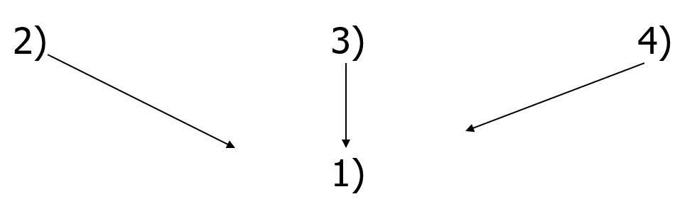
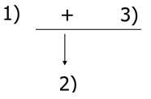
Linked or Independent Support?
Tom is probably a BT student (1). I saw him in the Biotech lab yesterday (2). Last week he was reading a textbook of Chemistry in the library (3). He often discusses topics of life science (4).
2. Amy is a marathon runner (1). She is probably very fit (2), given that if a person runs marathons, then he/she is probably very fit (3).
Independent support
Linked support
Notes:
(1)Ten witnesses say they saw Blotto rob the bank. (2)The stolen bank money was found in Blotto’s car. (3)Blotto’s fingerprints were found at the Teller’s window. (4)So, Blotto probably robbed the bank.
Independent support: If we remove one or two premises which support the conclusion, the conclusion is weaker, but it still makes sense.
(1)If Amy runs marathons, then she’s probably very fit. (2)Amy does run marathons. (3)So, Amy probably is very fit.
Linked support: The conclusion needs both premises to be valid.

Slide 24
Other Kinds of Support
Jim is an elderly man.
So, Jim probably doesn’t like hip-hop music.
So, Jim probably won’t be going to the underground music showcase tonight.
1)
2)
3)

Slide 25
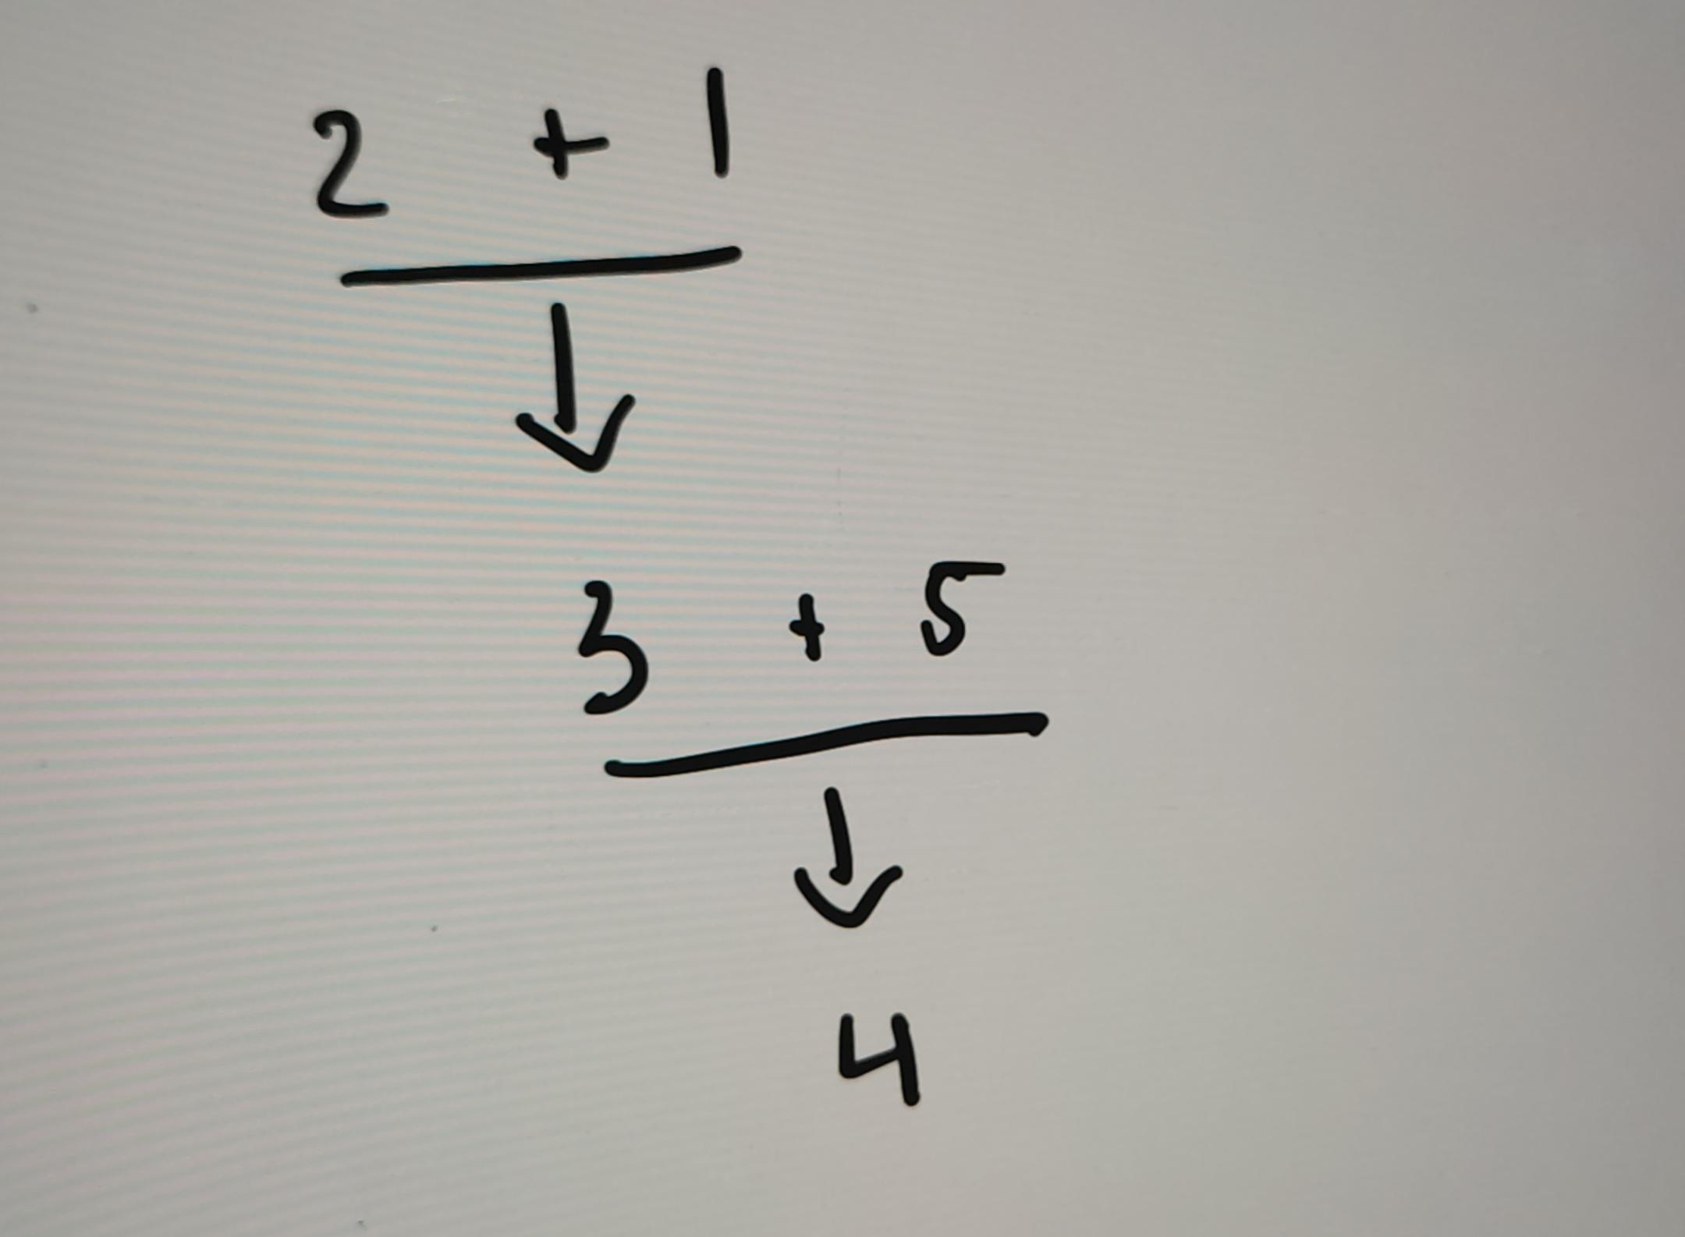
Other Kinds of Support
Example
Most IU students are BA majors, and An is an IU student. Thus, An is probably a BA major. Therefore, An probably supports the contest for potential business leaders, because most BA majors support the contest for potential business leaders.
1) Most IU students are BA majors
2) An is an IU student
3) An is probably a BA major
4) An probably supports the contest for potential business leaders
5) most BA majors support the contest for potential business leaders
Notes:
(1)Most IU students are BA majors, and (2)An is an IU student. (3)Thus, An is probably a BA major. (4)Therefore, An probably supports the contest for potential business leaders, because (5)most BA majors support the contest for potential business leaders.

Slide 26
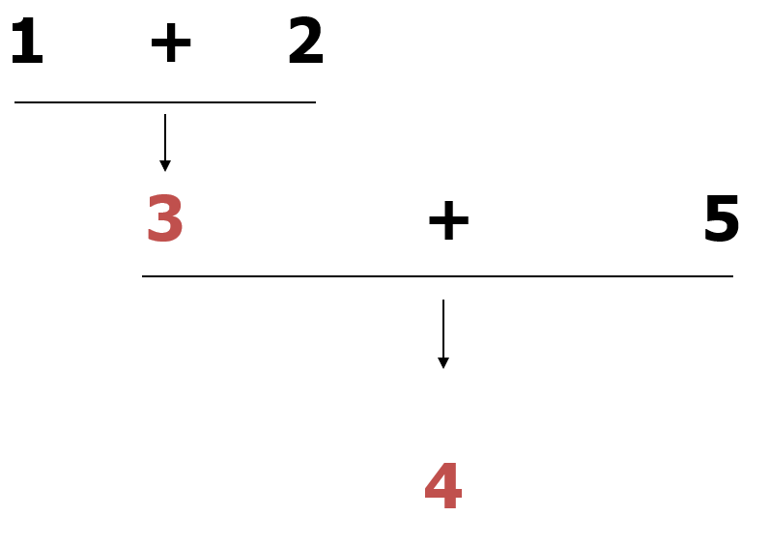
Other Kinds of Support
Example
Most IU students are BA majors, and An is an IU student. Thus, An is probably a BA major. Therefore, An probably supports the contest for potential business leaders, because most BA majors support the contest for potential business leaders.
1) Most IU students are BA majors
2) An is an IU student
3) An is probably a BA major
4) An probably supports the contest for potential business leaders
5) most BA majors support the contest for potential business leaders

Slide 27
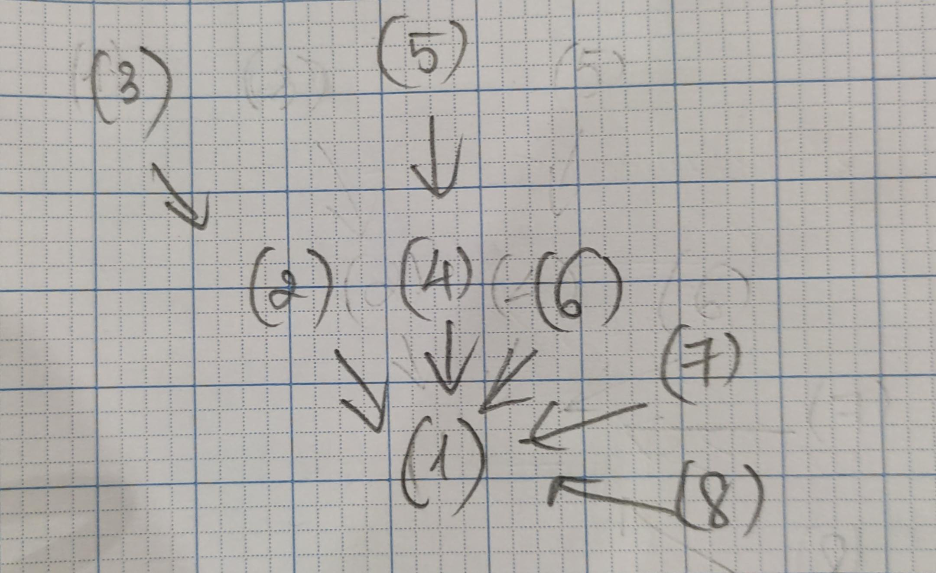
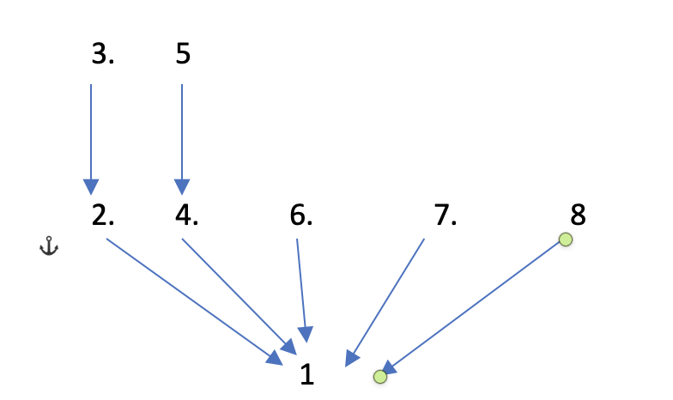
Other Kinds of Support
Cheating is wrong. First, it will lower your self-respect, because you can never be proud of anything you got by cheating. Second, cheating is a lie because it deceives other people into thinking you know more than you do. Third, cheating violates the teacher’s trust that you will do your own work. Fourth, cheating is unfair to all the people who aren’t cheating. Finally, if you cheat in school now, you’ll find it easier to cheat in other situations later in life – perhaps even in your closest personal relationships.
1) cheating is wrong
2) it will lower your self-respect
3) because you can never be proud of anything you got by cheating
4) cheating is a lie
5) because it deceives other people into thinking you know more than you do
6) cheating violates the teacher’s trust that you will do your own work
7) cheating is unfair to all the people who aren’t cheating
8) if you cheat in school now, you’ll find it easier to cheat in other situations later in life – perhaps even in your closest personal relationships
Notes:
(1)Cheating is wrong for several reasons. (2)First, it will lower your self-respect, because (3)you can never be proud of anything you got by cheating. (4)Second, cheating is a lie because (5)it deceives other people into thinking you know more than you do. (6)Third, cheating violates the teacher’s trust that you will do your own work. (7)Fourth, cheating is unfair to all the people who aren’t cheating. (8)Finally, if you cheat in school now, you’ll find it easier to cheat in other situations later in life – perhaps even in your closest personal relationships.

Slide 28
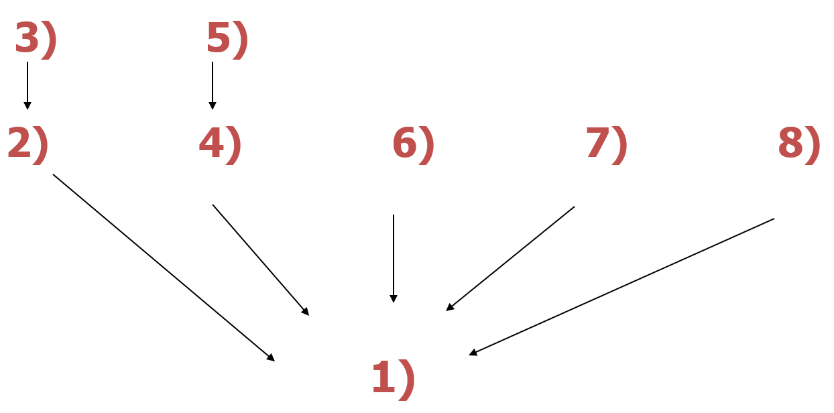
Other Kinds of Support
1) cheating is wrong
2) it will lower your self-respect
3) because you can never be proud of anything you got by cheating
4) cheating is a lie
5) because it deceives other people into thinking you know more than you do
6) cheating violates the teacher’s trust that you will do your own work
7) cheating is unfair to all the people who aren’t cheating
8) if you cheat in school now, you’ll find it easier to cheat in other situations later in life – perhaps even in your closest personal relationships
Notes:
Cheating is wrong for several reasons. First, it will lower your self-respect, because you can never be proud of anything you got by cheating. Second, cheating is a lie because it deceives other people into thinking you know more than you do. Third, cheating violates the teacher’s trust that you will do your own work. Fourth, cheating is unfair to all the people who aren’t cheating. Finally, if you cheat in school now, you’ll find it easier to cheat in other situations later in life – perhaps even in your closest personal relationships.

Slide 29
Tips on Diagramming Short Arguments
Pay close attention to premise and conclusion indicators.
Find the main conclusion and analyze it carefully.
Number the statements and/or expressions of cause-effect.
Note: Compound and complex sentences contain two or more separate statements.
4. Treat conditional statements (if-then) and disjunctive
statements (either-or) as single statements.
5. Don’t diagram irrelevant statements.
6. Don’t diagram redundant statements.

Slide 30
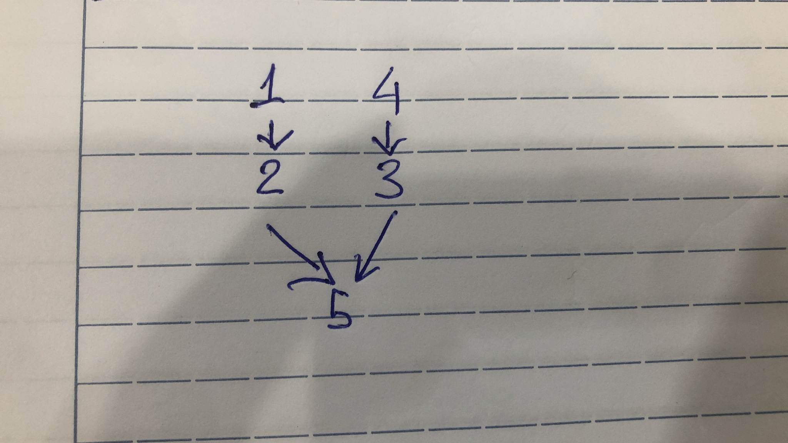
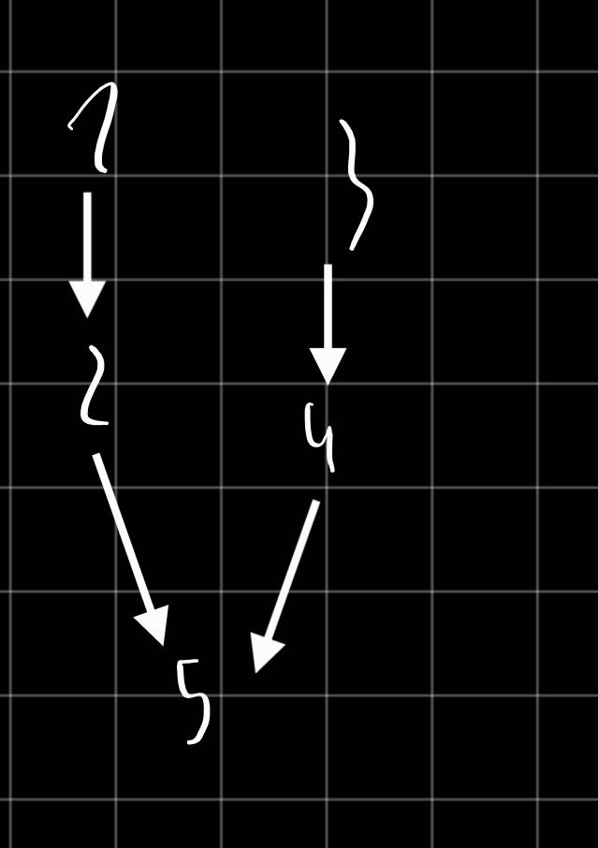
Diagram the argument
Two teenagers saw the movie, "Natural Born Killers," so they went out on a serial killing. A number of teenagers have committed violence at schools as a result of their many hours’ playing video games filled with murder and violence. We must have some stricter controls on the content of entertainment viewed by teenagers.
(1)two teenagers saw the movie, "Natural Born Killers"
(2) so they went out on a serial killing
(3) a number of teenagers have committed violence at schools
(4) as a result of their many hours’ playing video games filled with murder and violence
(5) we must have some stricter controls on the content of entertainment viewed by teenagers

Slide 31
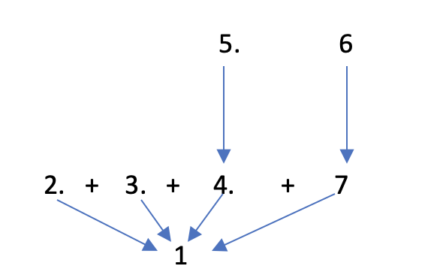
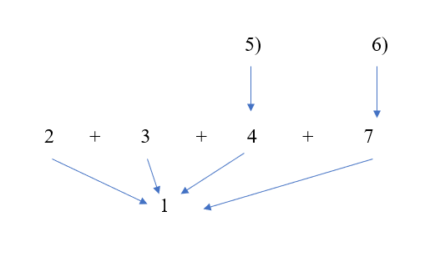
Diagram the argument
We cannot ignore the disastrous effects of TV on children. It appears to shorten the attention span of the young. It also seems to erode their linguistic powers and ability to handle mathematical symbolism. Television also changes their character in a negative way because violent programs increasingly make them impatient and cruel. More seriously, television opens all of society's secrets and taboos, thus it erases the dividing line between childhood and adulthood.
(1) We cannot ignore the disastrous effects of TV on children.
(2) It appears to shorten the attention span of the young.
(3) It also seems to erode their linguistic powers and ability to handle mathematical symbolism.
(4) Television also changes their character in a negative way
(5) Violent programs increasingly make them impatient and cruel.
(6) More seriously, television opens all of society's secrets and taboos.
(7) It erases the dividing line between childhood and adulthood.

Slide 32
Diagram the argument
We cannot ignore disastrous effects of TV on children. It appears to shorten the attention span of the young. It also seems to erode their linguistic powers and ability to handle mathematical symbolism. Television also changes their character in a negative way because violent programs increasingly make them impatient and cruel. More seriously, television opens all of society's secrets and taboos, thus it erases the dividing line between childhood and adulthood.
(1) We cannot ignore disastrous effects of TV on children.
(2) It appears to shorten the attention span of the young.
(3) It also seems to erode their linguistic powers and ability to handle mathematical symbolism.
(4) Television also changes their character in a negative way
(5) Violent programs increasingly make them impatient and cruel.
(6) More seriously, television opens all of society's secrets and taboos.
(7) It erases the dividing line between childhood and adulthood.

Slide 33
Task: Number the statements, clarify the references and diagram the following argument:
President Donald Trump on the election result (November 8, 2020)
“Beginning Monday, our campaign will start prosecuting our case in court to ensure election laws are fully upheld and the rightful winner is seated. The American People are entitled to an honest election: counting all legal ballots, and not counting any illegal ballots. This is the only way to ensure the public has full confidence in our election. It remains shocking that the Biden campaign refuses to agree with this basic principle and wants ballots counted even if they are fraudulent, manufactured, or cast by ineligible or deceased voters. Only a party engaged in wrongdoing would unlawfully keep observers out of the count room and then fight in court to block their access.”
https://apnews.com/article/transcript-statement-donald-trump-
Notes:
(1)Beginning Monday, our campaign will start prosecuting our case in court to ensure election laws are fully upheld and the rightful winner is seated. (2)The American People are entitled to an honest election: counting all legal ballots, and not counting any illegal ballots. This is the only way to ensure the public has full confidence in our election. It remains shocking that (3) the Biden campaign refuses to agree with this basic principle and wants ballots counted even if they are fraudulent, manufactured, or cast by ineligible or deceased voters. (4)Only a party engaged in wrongdoing would unlawfully keep observers out of the count room and (5)then fight in court to block their access.”

Slide 34
Task: Number the statements, clarify the references and diagram the following argument:
President Donald Trump on the election result (November 8, 2020)
Beginning Monday, our campaign will start prosecuting our case in court to ensure election laws are fully upheld and the rightful winner is seated.
The American People are entitled to an honest election: counting all legal ballots, and not counting any illegal ballots.
(This is the only way to ensure the public has full confidence in our election).
The Biden campaign refuses to agree with this basic principle.
(The Biden campaign) wants ballots counted even if they are fraudulent, manufactured, or cast by ineligible or deceased voters.
Only a party (Biden’s Democratic Party) engaged in wrongdoing would unlawfully keep observers out of the count room and then fight in court to block their access.
5
6
2
+
4
1

Slide 35
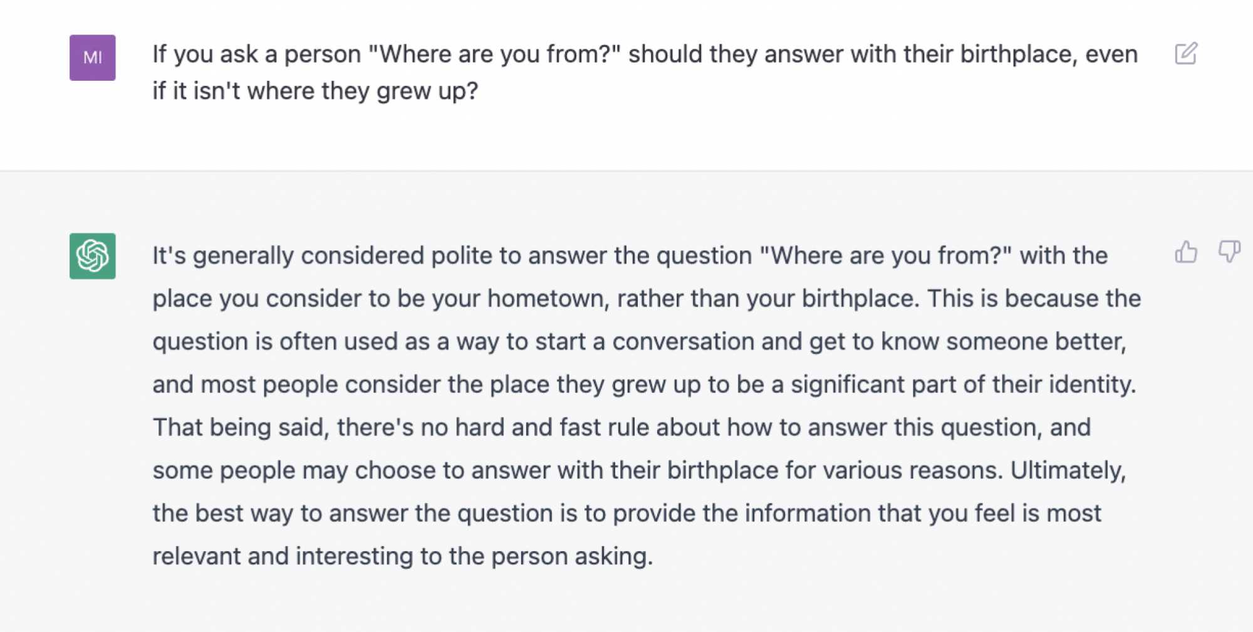
Task: Number the statements, and diagram CHATGPT’s argument:
Notes:
(1)It's generally considered polite to answer the question "Where are you from?" with the place you consider to be your hometown rather than your birthplace. (2) This is because the question is often used as a way to start a conversation and get to know someone better, and (3)most people consider the place they grew up to be a significant part of their identity. (4)That being said, there's no hard and fast rule about how to answer this question, and (5)some people may choose to answer with their birthplace for various reasons. (6)Ultimately, the best way to answer the question is to provide the information that you feel is most relevant and interesting to the person asking.

Slide 36
Part 2
Summarizing extended arguments

Slide 37
What does an extended argument look like?
Professor Jack W. Meiland, offering advice to college students:
There is one question which you should not ask, nor feel any temptation to ask, your instructor. That question is: “Will this be on the exam?” This question infuriates many instructors, and rightly so. For this question indicates that your main interest is in getting through the course with a good grade rather than in learning what the instructor has to teach. It is insulting to the teacher who has worked hard to put you in a position to appreciate the material - its intrinsic interest, its subtlety, its complexity.

Slide 38
Argument standardization
Purpose: to provide a summary of the argument that accurately restates the main points.
Argument standardization = a method for summarizing extended arguments.
Two important skills of argument analysis:
1. Paraphrasing
2. Finding missing premises and conclusions

Slide 39




Characteristics of a good paraphrase
accurate
clear
concise
charitable
Notes:
39

Slide 40
Skill 1. Paraphrasing
1. Be accurate: don’t misrepresent (like straw man)
Example: Europe has a set of primary interests, which to us have no, or a very remote relation to ours.
(1). Europe’s vital interests are totally different than ours.
(2). Europe has a set of vital interests which are of little or no concern to us.
Comment: (1) changes the original meaning; (2) is an accurate paraphrase.
Notes:
(

Slide 41
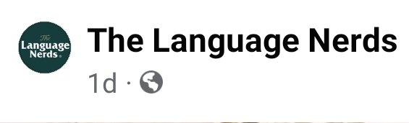
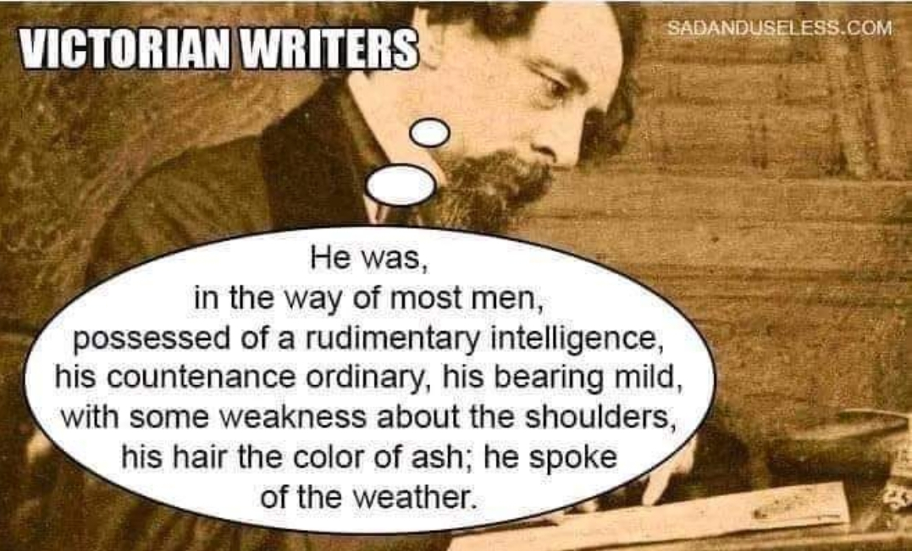
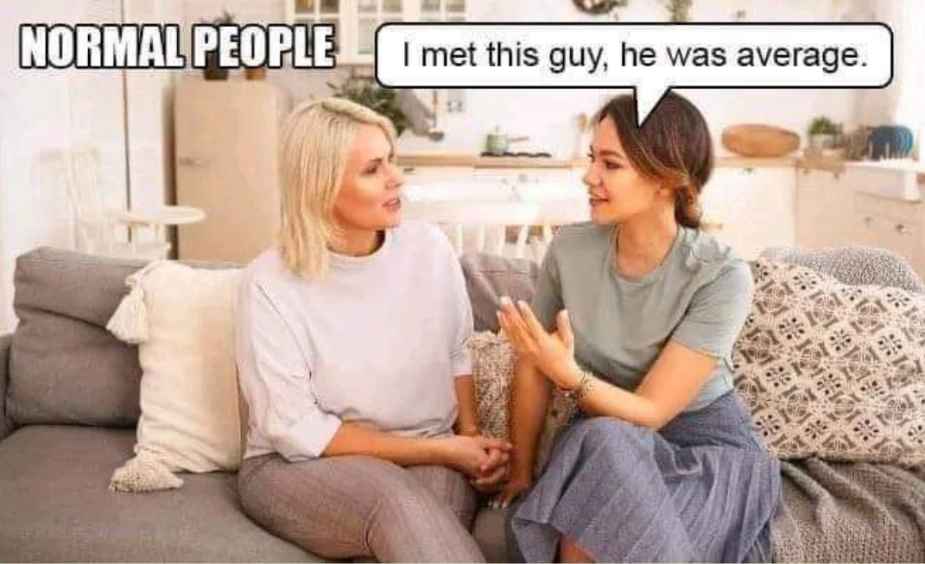
Skill 1. Paraphrasing (cont)
2. Be clear: Take confusion way and make it understandable.

Slide 42
Skill 1. Paraphrasing (cont)
3. Be concise: get to the bare essentials
Example: The office wasn’t open at that point in time, owing to the fact that there was no electrical power in the building.
Paraphrase: The office was closed then because there was no electricity in the building.

Slide 43
Skill 1. Paraphrasing (cont)
4. Be charitable: Again, avoid straw man
Example: Cigarette smoking causes lung cancer. Therefore, if you continue to smoke, you are endangering your health.
1. Cigarette smoking guarantees that you will get lung cancer. Continue to smoke and you will be unhealthy.
2. Cigarette smoking is a positive causal factor that increases the risk of lung cancer. If you continue to smoke, you risk being unhealthy.
Comment: (1) changes the original meaning by making the situation more serious than it actually is; (2) is an accurate paraphrase.

Slide 44
Task: Choose the best paraphrase
Black Friday does not really offer discounted deals because many suppliers set extremely high prices and then “discount” them.
Which of the following is a good paraphrase?
Black Friday does not attract a large number of buyers because its prices are too high at the beginning.
Customers are not really interested in online sales on Black Friday because it sets cutting prices.
Due to many of its much higher initial prices, Black Friday is not a sales promotion indeed.
Many customers do not care about Black Friday because they put quality before prices.
Notes:
Answer: C

Slide 45
Skill 2. Finding missing premises and conclusions
People often leave premises or conclusions out of their arguments.
Identifying missing premises: If there isn’t enough support for the conclusion, determine what is needed to support the conclusion and insert it.
Example: ‘You’re under 21. Therefore, I can’t sell you beer.’
Missing major premise: ‘It is illegal to sell beer to those under 21.’
Or: ‘By law, I can’t sell beer to anyone under 21.’

Slide 46
Task: Find the missing (major/minor) premises or conclusion and insert them to make good arguments (deductively sound or inductively cogent)
a. I must register my course schedule for next Semester 1. I’m a fresher.
Missing major premise: According to IU policy, all freshers register their schedule for next Semester 1 when they reach their 2nd year.
b. IU has various clubs which develop soft skills. Soft skills are increasingly required by employers.
Missing conclusion: So, high chances are that most IUers join one of these clubs.
c. You can’t skip Quiz 3. It is indicated in the syllabus that students take at least three quizzes to be qualified for the final exam.
Missing minor premise: You just took Quiz 1 and Quiz 2.

Slide 47
Summarizing extended arguments: what to do?
Read carefully to identify the main conclusion (or if it is missing).
Omit unnecessary/irrelevant statement.
Number the steps; put the conclusion first or last.
Fill in any missing premises or conclusions.

Slide 48
Summarizing extended arguments: What to avoid
1. Don’t write incomplete sentences
Error:
Because animals can experience pain and suffering. Therefore, it’s wrong to kill or mistreat animals.
Correct:
Animals can experience pain and suffering. Therefore, it’s wrong to kill or mistreat animals.
“I choose a lazy person to do a hard job. Because a lazy person will find an easy way to do it.” Bill Gates
“I choose a lazy person to do a hard job. This is because a lazy person will find an easy way to do it.” Bill Gates

Slide 49
Summarizing extended arguments: What to avoid
2. Don’t include more than one statement per line.
Error:
The CEO should resign since he no longer gains the confidence of the share holders.
Correct:
The CEO no longer gains the confidence of the share holders.
Therefore, the CEO should resign.

Slide 50
Summarizing extended arguments: What to avoid
3. Don’t include non-statements.
Error:
Trump and Biden are both American presidents, unlike me a Vietnamese.
So why should I care about American politics?
Correct:
Trump and Biden are both American presidents, but I’m a Vietnamese.
So I have no reason to care about American politics.

Slide 51
Summarizing extended arguments: What to avoid
4. Don’t include anything that is not a premise or a conclusion.
Error:
Critical thinking is both a professional and life skill.
All non-political courses at IU are taught in English.”
Critical Thinking is a non-political course.
Therefore, Critical Thinking is taught in English at IU. (from 2,3)
Tip: (1) doesn’t support the conclusion, so leave it out of the standardized argument.

Slide 52
Practice: Standardize this argument
Professor Jack W. Meiland, offering advice to college students:
There is one question which you should not ask, nor feel any temptation to ask, your instructor. That question is: “Will this be on the exam?” This question infuriates many instructors, and rightly so. For this question indicates that your main interest is in getting through the course with a good grade rather than in learning what the instructor has to teach. It is insulting to the teacher who has worked hard to put you in a position to appreciate the material - its intrinsic interest, its subtlety, its complexity.

Slide 53
Standardized argument 1
Professor Jack W. Meiland, offering advice to college students:
(1)You should not ask your instructor about the exam contents. First, (2)your question indicates that you’re more interested in a good grade rather than in learning, so (3)it makes your instructor angry. Second, (4)this question is insulting to your instructor because (5)he/she has made great efforts to inspire you with the lesson.
2
5
3
4
1

Slide 54
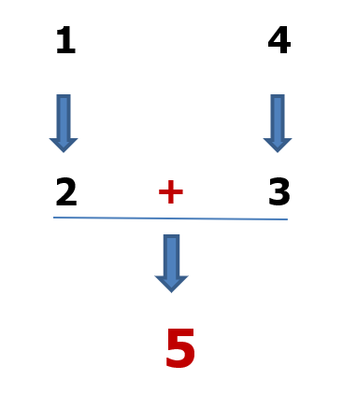
Standardized argument 2
Professor Jack W. Meiland, offering advice to college students:
(1) Your question about the exam contents indicates that you’re more interested in a good grade rather than in learning, so (2)it makes your instructor angry. (3)This question is also insulting to your instructor because (4)he/she has made great efforts to inspire you with the lesson. (5)For those reasons, you should not ask your instructor about the exam contents.

Slide 55
Practice: Standardize this argument
My opinion regarding the amount of homework a child receives is basically threefold. I don’t believe the children should receive any homework whatsoever. One, because the teacher has seven or eight hours during the course of the school day to instruct children and do assignments with them, to review material for tests. They do not need to be sending work home. To me, homework is an excuse for a teacher’s lack of ability to do their job properly. Two, there are too many children that come home with either no adult there or no adult with the ability to help them with their homework. That places too many children at a disadvantage compared to other children who have their parents there to help them with their homework. Three, an adult spends eight hours at work, comes home, and has the rest of the day to enjoy themselves. That is a luxury that a child should definitely be afforded. They don’t need to spend time after school. Teacher, it is time to wake up.

Slide 56
Standardized argument
Children should not be given any homework for three reasons. First, they work enough with their teachers in class for eight hours, so no more assignments or review materials are needed at home. Second, homework is an obstacle for too many children who have no adult relatives to help or unable to help. Third, like adults, children need a rest after 8 hours at school.

Slide 57
Assignment
Do the FIVE tasks in the next slides.
Link to submit:
https://forms.gle/mBrGhEDPUMoKs2Pe9
Note: Delete lesson slides; only keep the assignment slides.

Slide 58
Task 1: Number the statements and diagram the argument
It is high time drivers turned to hybrid cars which run on gas and electricity as an effective energy solution. These cars automatically turn off their engine when they are not moving. They do not waste energy when they are stuck in traffic or stop long at traffic lights. The electricity source in hybrid cars is a battery. It recharges itself when drivers use the brake. That way, drivers save their time plugging their cars in for a re-supply. Hybrid cars also have smaller engines. This means they consume less gas. Regular cars consume more gas than they do. Hybrid cars are a great choice for those who care about fashion.

Slide 59
Task 2: Number the statements and diagram the argument
Computer games can influence children critically. These games separate young players from society, so children cannot learn the important lessons that require social interaction. In addition, these games only focus on patterns. That is why children do not develop their mental skills well if they are addicted to computer games. Unlike traditional games which teach children how to work in a team or how to solve problems, computer games give children no preparation for their future work or life. If you are parents, remove or block games on the computers that your children use.

Slide 60
Task 3: Number the statements and diagram the argument
A large number of first-year students have to spend one or two semesters on classes of intensive English, so the summer semester helps them shorten their college time. This 3rd semester is half length of the regular semesters, so teachers plan more focused lesson contents. The mid-term exam is also combined with class time; therefore, its test contents are more or less adapted. Nevertheless, the summer semester takes away the fun moments which most students look forward to. As can be seen, for many IUers, the summer semester is not really discouraging.

Slide 61
Task 4: Indicate the premises and the conclusion, then summarize the argument.
Television can play an important role in educating children, but its overwhelming influences are really worrying. Television is an essential device in nearly all household. Television has been increasingly replacing the traditional roles of families and schools, so children’s attitudes and behavior have been changed as a result. Advertisements of processed foods and drinks are so frequent on TV, which causes children to consume more and more unhealthy foods. TV commercials need to be limited. Children may watch violent scenes on TV and they become more and more aggressive. This is because parental attention is not always available.

Slide 62
Task 5: Standardize this argument and diagram it
When we join public pages or groups of the same interests on social media, we can learn from other members’ contributions and thus, we can have more knowledge or skills what may take us a lot more time to acquire if we do the other ways like joining schools or face-to-face study groups. Social media can be such a fun and entertaining way to communicate, catch up, and keep in touch with family and friends who are far away. The means of interactive communication allows users to call, by voice and on video, or text, or chat, or comment and reply to comments on their posts. Then on the other spectrum, it is very important to know that social media can be a dangerous place as well. We hear lots of stories about online predators, catfishing and other stories like that. It is important to know the dangers of social media and be wary of them. More, it can be such a political, religious, gossip column that leads so many to take others' views, comments and opinions out of context that it becomes an almost evil entity. Not to mention that I feel certain subjects and info shouldn't be shared if it isn't their business to do so such as suicide news or notes, along with personal addresses and so forth. Like everything in this life, social media can be a beneficial and harmful environment."

Slide 63
Task 5: Standardize this argument and diagram it
Standardized argument:
Diagramming:
Numbered statements:

Slide 64
Task 6: Cite a real-life argument, standardize it with numbered statements, and diagram it
Argument
Numbered statements:
Diagramming:
Source:

Slide 65
Week 11 – Attendance

Slide 66
Project Preparation
Assignment: Each group is required to select an input video of + 3 minutes (in English or Vietnamese) about a controversial topic or with controversial contents.
Specific tasks will be given next week.

Slide 67
THANK YOU

